Slide 1


Response Selection Chatbot for
Goal-Oriented Dialogue
Group 1
Aydar
Seungwoo Yoon
Chansu Park
Shinhyung Kim
Notes:
Hello. We are Team 1. We will introduce a response selection chatbot for Ubuntu dialog corpus.

Slide 2

Table of Contents
Motivation
Problem Description
Baseline Model
Our Model
Results
Possible application
Conclusion
Notes:
Here is the table of contents.

Slide 3
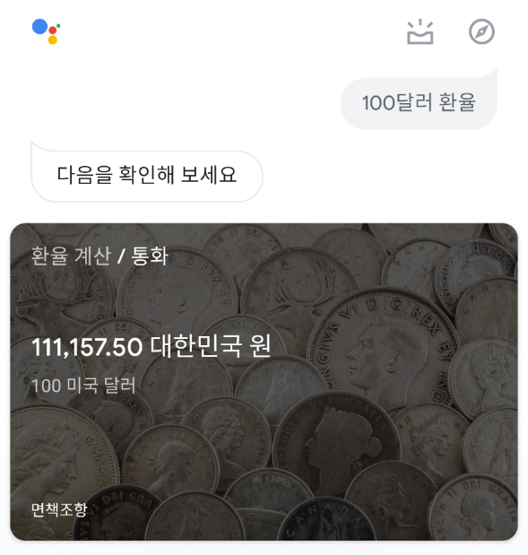
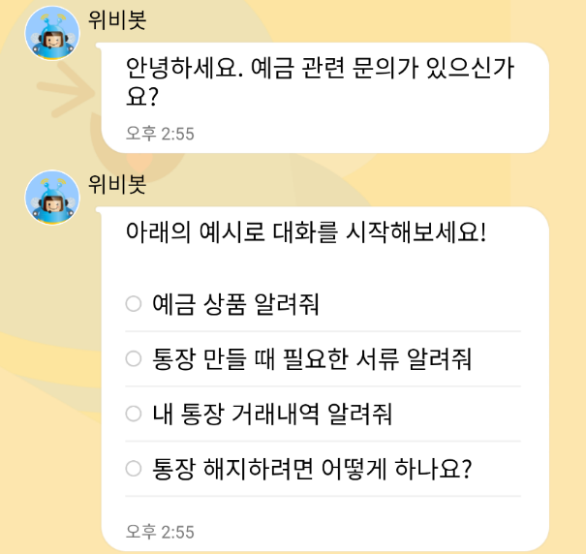
Motivation
Context/Goal recognition is important for AI
To interact with humans, robots have to understand what is needed for humans and have to answer/react properly.
As an example, many companies launch their chatbots to solve customers requests automatically.
Google Assistant
Wooribank
(Deposit/Savings part)
Notes:
Machine learning developed many breakthrough results like classifying images, object detection, and so on.
Additionally, recent researches and products have introduced AI which recognizes the context of the situation.
For the sense of the intelligent mechanics, robots have to interact with humans properly, so they have to understand what is needed for humans.
As a user-friendly product, many companies launched their chatbots to solve customers requests.
For instance, Google launched google assistant for their android phones.
Banks of Korea also introduced their own clerks and encourage users to get the answer by text dialogue.

Slide 4
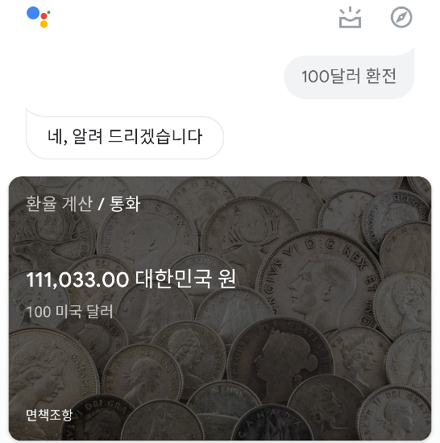
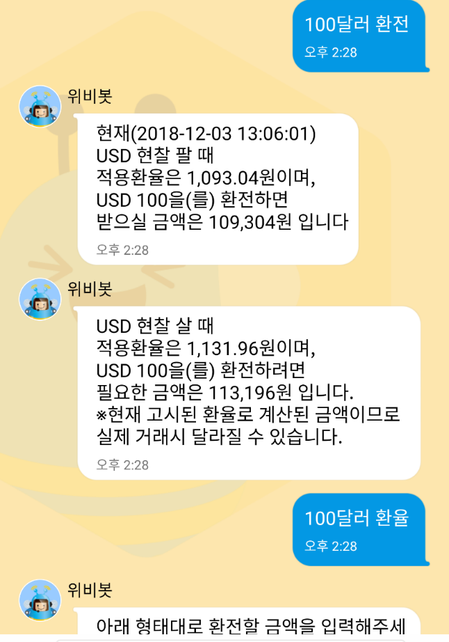
Motivation
Chatbots have to answer similarly for inputs having similar meaning. Also, they somehow have to recognize not a full sentence, even with broken grammar or some typos/abbreviations.
Currently, some chatbots cannot do that.
← Succeed to ask 환전 (exchange), but failed to ask 환율(exchange rate)
This chatbot cannot recognize similar words.
Acts same as previous slide
Notes:
There are some properties for chatbots.
For instance chatbots have to answer similarly for inputs having similar meaning.
Even if we enter exchange rate of 100 dollars rather than the exchange of 100 dollars on the bank clerk, we want to get the amount of Korean won corresponding to 100 dollar.
Sometimes, we may enter a not-completed sentences, typos, or even abbreviations for the chatbot, but still want to get a right answer.
However, many chatbots don’t have that properties.
In this example, I succeeded to ask exchange, but failed to ask exchange rate on this clerk.

Slide 5
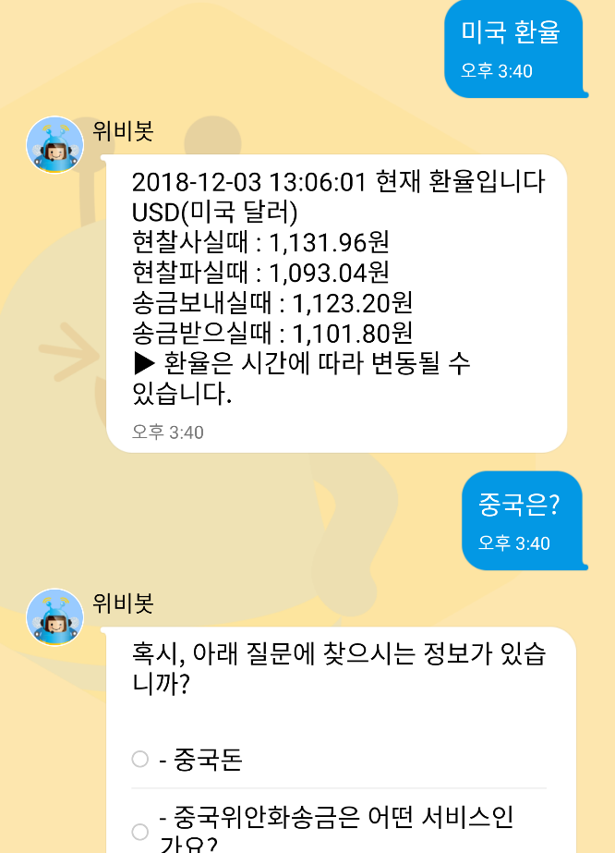
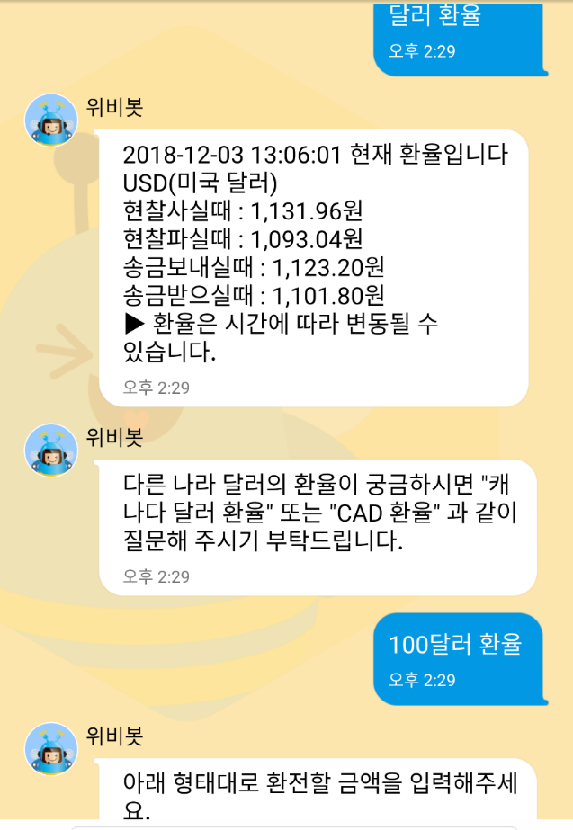
Motivation
Performance of some chatbot is awkward
← After asking 미국 환율 (dollar exchange rate), asking 중국은? (What about china?) makes failure to get an answer
← Succeed to ask 달러 환율 (dollar exchange rate), but failed to ask 100달러
This chatbot cannot recognize neither context nor similar usage.
Notes:
As the matter of context, we sometimes omit some parts of the sentence when we talk to each other.
In the left example, you can see that the clerk didn’t reply according to the context.
This clerk also failed to recognize similar usage.
When I just added 100 on my text, the clerk replied to make me follow the form of the input to exchange.
It is just a rule-based answer, so it means that this chatbot cannot recognize the similar usage.

Slide 6
Problem Description
Implement a chatbot which recognizes a two-person goal-oriented conversation including
Chatting log format
Expertized terminology (task-specific domain)
Text-based emojis
And then select right reaction from the answer pool, which should not be hand-crafted, rule-based systems or based on hand-crafted features.
Two kinds of problem setting
Generation task: too wide possible response pool, cannot expect a proper response in most cases.
Selection task: provide a limited response pool, makes chatbot to find the more accurate response.
Notes:
Because of that, we decided to implement a chatbot which can take care about the two-person goal-oriented conversation with wrong grammar, typos, and even needless emoji.
Additionally, we took care about expertized terminology from task-specific domain.
What we want to do is let the chatbot selects the right reaction from the answer pool.
We originally planned to generation problem, but we turned it into the selection problem.
Generation task has too wide possible response pool which makes us not to expect a proper response in most cases.
However, selection task provides the response set, which makes chatbot to find the more accurate response.

Slide 7
Problem Description
Dataset: Ubuntu Dialogue Corpus ¹
collection of logs from Ubuntu-related chat rooms
prepared to solve an Ubuntu user’s posted problem
appropriate dataset to construct response sentence selection model for goal-oriented conversation (like bank clerks)
Details
Task: select the next utterance from given candidate set
Candidate set will contain between 1 option that is correct and 99 options that are incorrect (for a total of 100).
Evaluation criteria: Correct accuracy of the results from Top n in 100 (n = 1, 2, 5, 10, 50)
Notes:
For this purpose, we decided to use Ubuntu dialogue corpus.
This dataset is the collection of logs from Ubuntu-related chat rooms. The goal of each data is to solve an Ubuntu user’s posted problem from the two-person dialogue.
Since our target is to implement response sentence selection model for goal-oriented conversation, we selected this dataset.
Here is the formal detail.
The given task is to select the next utterance from given candidate set with one hundered of sentences,
where the only one of them is the correct answer.
The performance of the chatbot will be decided by the accuracy of the results from Top n in 100.
(For instance, Top 1 accuracy measures the number of right responces among the whole responses.)

Slide 8
Problem Description
=================== Context ===================
User1: ugh ubuntu wotn read my ipod... i can acess the harddrive but gtkpod wont recognize it.. :(
User2: Try rhythmbox. rhythmbox reads ipods nicely in breezy
User1: SEjeff, i can put songs on my ipod through rhythmbox?
=================== Correct Answer ===================
82: No, but I got gtkpod to work perfectly with my nano and breezy
=================== Example of utterances =================== 3: I doubt they would even consider giving support...
12: no
26: I'm not sure then.
41: ok, let that finish first then
67: use /join #kubuntu-de
82: No, but I got gtkpod to work perfectly with my nano and breezy
91: I dont know, you said it was 4yrs old, I thought you may know of the bug off hand.
98: itm must be in options - somewhere
Notes:
Here is an example of the dialogue. In this dialogue, user 1 wants to recognize his ipod on the Ubuntu via gtkpod and write some songs into his device.
The proper answer in this case should be a sentence what user2 experienced on that tool.
In the dialogue, you can see some typos and wrong grammars on the user1.
In the candidate set, there are some possible simple answers like No on number 12, hesitating answer on number 26, and so on.

Slide 9
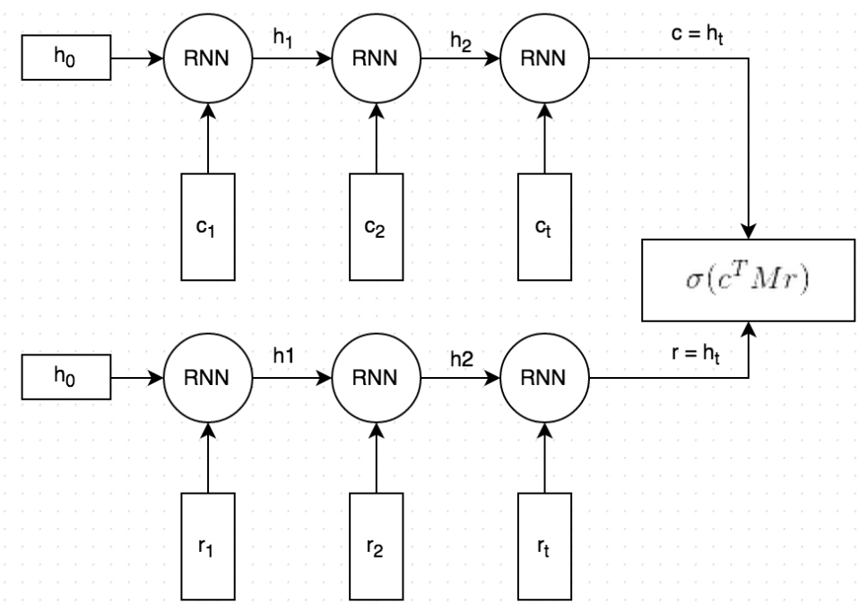
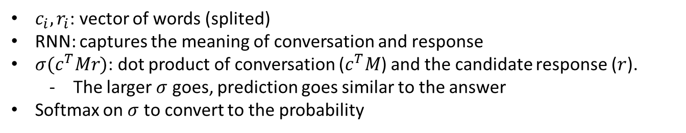
Baseline Model
conversation
probability
Softmax
100 responses
response
$c_{i}, r_{i}$: vector of words (splited)
RNN: captures the meaning of conversation and response
$σ(c^{T}Mr)$: dot product of conversation ($c^{T}M$) and the candidate response ($r$).
The larger $σ$ goes, prediction goes similar to the answer
Softmax on $σ$ to convert to the probability
Notes:
In the same paper that introduced Ubuntu dialogue corpus, they introduced their baseline model to decide the right result.
It takes conversations and responses as a vector of words, and the recurrent neural network captures the meaning of each sentences.
Then it predicts the response and compares to the actual response by taking dot product.
As the dot product gets bigger, the prediction goes similar to the answer.
Finally, it converts that value to the probability.
Then it sorts the probability for each candidates to get the top n answers.
Now we will introduce our model.

Slide 10
End-to-End Memory Network (MemN2N)
Advantages of Memory Network
Non-decaying memory
Other naïve approaches such as LSTM is prone to exponential memory decay due to structure.
Two different memory representation with different function
Input and output which allows to compute match between text (conversation) and response
Multi-hop helps with augmenting all relevant information
Mimics human behavior to reread text to better understand the context
Notes:
For our implementation we decided to start with End-to-End Memory Network. Its structure allows to store memory, which is similar to forget gate in LSTM, but can be stored for entire text or communication (hold weights for each word or sentence). This has few advantages. First, as conversation get longer and longer, other approaches such as LSTM tends to be coy to memory decay due its structure, but in MemN2N it is avoided. Second, it has two different memory representation, for so called input and output, which allows to compute match between text (conversation) and response. Third, we use multi-hop operations, which is basically speaking is mimicking human behavior by rereading relevant text multiple times to extract key ideas.

Slide 11
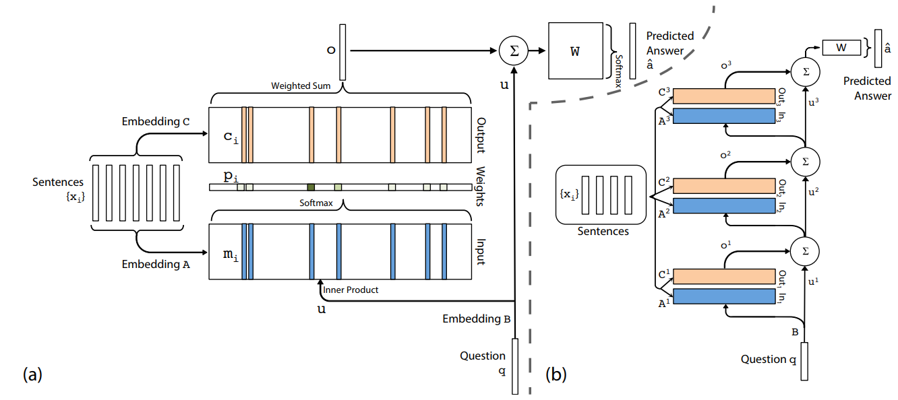
MemN2N
Embedding matrices A, B, C are learned during training
Increasing hops improves performance
Notes:
This is structure MemN2N. Let me first explain, one layered structure. Originally, sentences are used for embedding. As it was said before, two memories are used, input and output. Input memory is embedded by matrix A, and relevant question is embedded by matrix B. Then Input memory and Embeded question are used for identifying weights for output memory. Then weighted output memory is used to generate answer. In multi-layered, or multi-hop case, simply output of previous layer is combined with its input, to identify input of next layer. It is similar to human behavior when people re-read material to understand more context.

Slide 12
MemN2N
Disadvantages of Memory Network
Naïve sentence encoding
Encoding based on Dictionary and Bag of Words
Encode sentences separately
Embedding matrices A and C are too weakly supervised
Input of A and C are exactly the same.
No guarantee that A and C are learned according to their roles.
Notes:
Although this method is better than classical RNN or LSTM, we believe it is still does have disadvantages. First is naïve sentence encoding. In original paper authors proposed to use dictionary for word representation, which is limiting usage to mistake-free conversations. Then they use Bag of Word encoding, which is simply encoding each sentence without caring about position of words or relative position of words. They also encode each sentence, not word, which can fail to identify key words.
Second is learned matrices are weakly supervised. Both input and output memory embedding uses same input but have totally different roles, in network. We believe that that network would increase its performance if we apply more supervision there.

Slide 13
Our Model
Bidirectional context encoded word representation by LSTM
Use word2vec for word inputs.
Bidirectional LSTM encoders to encode every word in the conversation with forward, backward, and bidirectional context.
Encoded words comprise three non-decaying memories
Sentence-to-word level attention and multi hop
Finds and augments context-encoded keyword that is relevant to itself
Each candidate response reads conversation back and forth multiple times
Notes:
Therefore, we developed our own model which overcomes theses shortcomings. First, we use bidirectional LSTM to encode words. We use pretrained word2vec model to represent each word. This way words with mistakes can be used in input. We encode each word with forward, backward and bidirectional context, to give more context for each word. Since we use MemN2N for each word and LSTM only for word embedding, decay of memory is avoided. Second, we use sentence to word level attention, and multi hop operation. We process conversation by its own to find augmented conversation. Then we embed each candidate response with conversation, and using multi-hop process we try to find augmented response. In order to score each response we test difference in augmented conversation and augmented response.

Slide 14
Results
Example1: Best Prediction
Context
User1: ugh ubuntu wotn read my ipod... i can acess the harddrive but gtkpod wont recognize it.. :(
User2: Try rhythmbox. rhythmbox reads ipods nicely in breezy
User1: SEjeff, i can put songs on my ipod through rhythmbox?
ChatBot!
Top 5 prediction
82: No, but I got gtkpod to work perfectly with my nano and breezy
38: try "sudo mount -t usbfs none /proc/bus/usb“
85: absofrigginlutely
24: it depends on what your repos say, are you in breezy or dapper?
86: Browse to your /media folder, that should have a logical name
Notes:
Let's talk about the results of our chatbot. This is a great situation. Here is a con text . User1 and user 2 are talking about Compatibility between iPad and Ubuntu. And chatbot predict next conversation.
Below examples are chatbot’s choisen. Higher probability sentanse is existing upper side. So in this examples, chatbot correctly predicted sentences.

Slide 15
Results
Example2: Second Best Prediction
Context
User1 : so. how can i generate the hu_HU locale?
User2 : dpkg-reconfigure locales
User1 : it doesn't answer anything in dapper...
ChatBot!
Top 5 prediction
89: bash --version
98: well, wait until Dapper is released.
3: lemme try it and see. hm i dunno, maybe it doesn't
94: try :0.0
86: http://users.fishinternet.com.au/~peterg/edistheeditor.txt. ;-)
Notes:
And look at this simuation. They are talking about locale and Dapper. And chatbot predict next conversation those 5 sentence. In this examples, If only show one sentence that highest prediction . Than chatbot doesn’t correctly predicted sentences. Answer is secondly highest sentence.

Slide 16
Results
ChatBot’s prediction Accuracy
Using Ubuntu Dialogue Corpus dataset
Chatbot | Top1 | Top2 | Top5 | Top10 | Top50
Our model | 20.32% | 29.37% | 42.19% | 53.62% | 87.24%
Baseline | 8.32% | 13.36% | 24.26% | 35.98% | 80.04%
2.5 times increased accuracy
Notes:
So, we make a table to show our chatbot’s ability. Datsset is used DSTC7(ubuntu) files. We doing experiment twice, and calculate average prediction. Look at the top 1, our chatbot’s prediction rate is around 20%. 이는 기존 모델에 비해 2.5배 정도 정확도가 상승한 수치이다. Top1 이 아닌 top2, top5, top10으로 가게되면 정확도가 점점 상승하는 것을 볼 수 있다. Top 50의 경우 baseline과 단지 7% 정도만 차이난다.

Slide 17
Applications
Possible application area
Daily dialog based tasks
The correct answer must be given
User must make the final decision
Examples
Various program helper(F1)
Online bank service – webee talk2.0
Dialog based self-diagnosis system
Notes:
그다음 우리는 정확도가 항상된 챗봇이 적용될 수 있는 분야에 대해 발표하겠다. 먼저 우리의 이러한 알고리즘이 적용 되기 위해서는 다음과 같은 조건을 만족해야 된다. 먼저 대화 기반이여야 된다. 우리의 챗봇은 이모티콘, 축약어, 비속어 등을 사용한 일상적인 대화 기반으로 학습이 가능하기 때문에 일상 언어에 강점을 가진다. 그다음 적용분야는 답이 manual 하게 정해져 있여야 된다. 그래야 챗봇이 정해진 답을 찾아서 나아갈 수 있다. 마지막으로 최종 선택은 유저가 해야만 한다. 아직은 정확도가 많이 높지 않기 때문에 유저가 답을 선택하는 어플리케이션에서 조언을 주는 정도로 사용할 수 있다. 이러한 조건을 만족하는 대표적인 예제들로는 프로그램 사용 도움이, 온라인 은행 서비스, 대화 기반 자가 질병 검진 시스템을 찾아 보았다.

Slide 18
Applications
Online bank service
Customer enters his requirements into Chatbot
Recommend the listed financial products based on conversation
Customers select financial products based on listed financial product with accuracy
Dialogue based self diagnosis system
The patient enters his symptoms into ChatBot
Provide a manual prescription based on input conversation
Provide proper manual prescription analysis based on conversation content
Notes:
먼저 온라인 은행 서비스 이다. 앞에서 예시로 든 바와 같이 온라인 은행업무는 요즘들어 대화형 방식을 적용하고 있으며 은행업무는 고도로 메뉴얼화 되어 있다. 따라서 다음과 같이 입력된 대화를 챗봇이 인식하고, 대화기반으로 알맞은 금융 상품을 추천하거나 원하는 금융 업무를 도와주는 다양한 선택지를 유저에게 제공할 수 있다. 유저는 그중 하나의 선택지를 골라가면서 점점더 알맞은 금융상품을 얻을 수 있을 것이다.
대화기반 자가 질병 검진 시스템도 쳇봇이 활약하기 좋은 분야이댜. 먼저 자신의 증상과 같은 정보를 쳇봇에 입력하면 쳇봇은 고도로 메뉴얼화 되어있는 의료 정보 가운데에서 적절한 질병을 찾아주게 된다. 이때 유저는 챗봇이 제시하는 여러 선택지 가운데 가장 자신의 증상과 비슷하다고 생각되는 선택지를 골라 가게 되면 결국 높은 확률로 자신의 증상이 어떤 질병에 속하는지 알게 될 것이다.
두 방식 모두 대화를 하면 할수록 더 나은 정보를 제공해 줄 수 있는 점에서 정확도를 높게 올릴 수 있게 되는 장점이 있다.

Slide 19
Conclusion
Chatbot’s results and application
Chatbot is a dialogue based response selection model, and the accuracy is up to 2.5% higher than the baseline model
Chatbot can be applied to conversation based problem, and a set of candidates for answer
Ex) Online bank service, program helper(F1), Dialog based self-diagnosis system
Future work
Response generation task
Notes:
마지막으로 지금까지 과정을 요약하면서 피피티를 마치겠다.
먼저 우리가 만든 쳇봇은 다음과 같은 원리로 작동한다
~~~~~~~~~
위와 같은 모델을 적용하였을때 쳇봇은 기존 보델보다 최대 2.5 배 높은 정확도를 가지고 여러 개의 메뉴얼화된 선택지중에 하나의 정답을 고를 수 있다.
이를 이용해서 온라인 은행 서비스, 프로그램 도움말, 자가 진단 시스템등에 응용될 수 있을 것이다.

